Slide 1
Big Data Case Study​
Cisco Systems​
Abhinav Ralhan
11 July 2023

Slide 2
Topics
Introduction​
Big Data​
Key Products / Services​
Big Data Applications​
Current Situation​
References​

Slide 3
Introduction
Cisco Systems, Inc., commonly known as Cisco, is an American-based multinational digital communications technology conglomerate corporation headquartered in San Jose, California. Cisco develops, manufactures, and sells networking hardware, software, telecommunications equipment and other high-technology services and products. Cisco specializes in specific tech markets, such as the Internet of Things (IoT), domain security, videoconferencing, and energy management with leading products including Webex, OpenDNS, Jabber​.

Slide 4
Data
Network Data: Cisco collects and analyzes data from network devices, including routers, switches, firewalls, and wireless access points. This data includes network traffic, performance metrics, bandwidth utilization, and network configuration details.​
Security Event Data: Cisco's security solutions capture and analyze security event data, such as logs, alerts, and anomalies generated by firewalls, intrusion detection systems, and other security devices. This data helps in identifying potential security threats and responding to incidents.​
IoT Sensor Data: Cisco's IoT platforms and solutions gather data from connected devices and sensors in various domains, including industrial, transportation, and smart cities. This sensor data includes measurements, status updates, and environmental information that provide insights into device performance, usage patterns, and operational conditions.

Slide 5
Data
Customer Data: Cisco captures and analyzes customer data to improve customer experience and support personalized interactions. This data can include customer profiles, purchase history, support tickets, and feedback from various channels like contact centers, websites, and social media.​
Collaboration and Communication Data: Cisco's collaboration and communication solutions, such as Webex, capture data related to meetings, messaging, and collaboration activities. This includes information on participant engagement, call quality, messaging patterns, and content sharing.​
Service Provider Data: Cisco works with service providers and telecommunications companies, collecting data related to network traffic, subscriber usage, service quality, and customer behavior. This data helps service providers optimize network performance, improve service offerings, and enhance customer experience.

Slide 6
Products / Services
Data Lakes: Cisco captures and analyzes customer data to improve customer experience and support personalized interactions. This data can include customer profiles, purchase history, support tickets, and feedback from various channels like contact centers, websites, and social media.​
Accelerated Compute: Cisco's collaboration and communication solutions, such as Webex, capture data related to meetings, messaging, and collaboration activities. This includes information on participant engagement, call quality, messaging patterns, and content sharing.​
Object Storage: Cisco works with service providers and telecommunications companies, collecting data related to network traffic, subscriber usage, service quality, and customer behavior. This data helps service providers optimize network performance, improve service offerings, and enhance customer experience.

Slide 7
Big Data Applications
​Network Monitoring and Analytics: Cisco offers network monitoring and analytics solutions that leverage big data to provide real-time insights into network performance, security threats, and overall network health. By collecting and analyzing network data, organizations can proactively identify issues, optimize network operations, and enhance security.​
Internet of Things (IoT) Data Management: Cisco provides IoT platforms and solutions that enable organizations to collect, manage, and analyze data from connected devices and sensors. They leverage big data analytics to process and gain insights from the vast amounts of IoT-generated data, enabling businesses to monitor, control, and optimize their IoT deployments.​
Cybersecurity and Threat Intelligence: Cisco's security solutions employ big data analytics to detect and mitigate cyber threats. By analyzing large volumes of security event data, network traffic patterns, and threat intelligence feeds, Cisco can identify anomalies, detect potential security breaches, and respond to threats in real-time.​

Slide 8
Big Data Applications
Customer Experience and Personalization: Cisco helps organizations utilize big data analytics to enhance customer experience and personalize interactions. By analyzing customer data from various sources, such as social media, contact centers, and website interactions, businesses can gain insights into customer preferences, behavior, and sentiment to provide tailored experiences and improve customer satisfaction.​
Predictive Maintenance and Asset Optimization: Cisco's big data applications is utilized in industries such as manufacturing and transportation to enable predictive maintenance and optimize asset performance. By analyzing sensor data, historical maintenance records, and other relevant data sources, organizations can identify patterns and anomalies, predict equipment failures, and optimize maintenance schedules to reduce downtime and increase operational efficiency.​

Slide 9
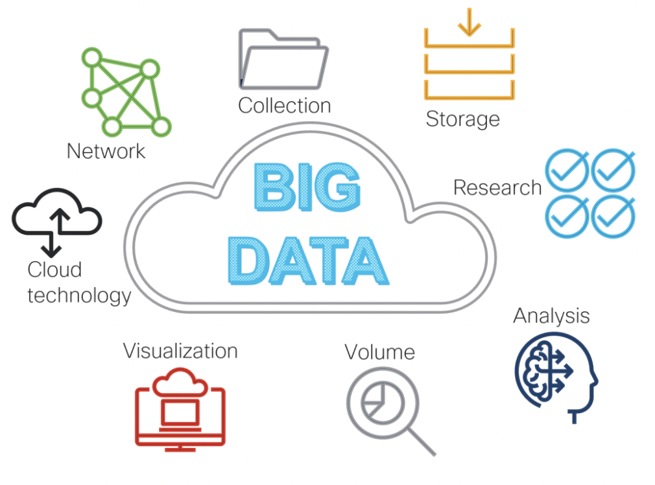
Current Situation
The digital lifecycle journey data science team has many predictive models for understanding Cisco’s customers. This includes analysis of customer purchasing behavior, digital activity, telemetry, support interaction, and renewal activity using a wide variety of machine learning based algorithms. They apply the latest and greatest forms of advanced statistical and deep learning based supervised learning methods for understanding and predicting the expected behavior of our customers, their interactions with Cisco, and their interactions with Cisco products and services. They quantify and predict metrics valuable to both Cisco and Cisco’s customers.

Slide 10
References
https://blogs.cisco.com/analytics-automation/answering-the-big-three-data-science-questions-at-cisco
https://blogs.cisco.com/financialservices/big-data-explosion
https://blogs.cisco.com/analytics-automation/connecting-data-sources
https://www.cisco.com/c/en/us/solutions/data-center-virtualization/big-data/index.html?dtid=osscdc000283
https://en.wikipedia.org/wiki/Cisco
https://hbr.org/2015/05/ciscos-ceo-on-staying-ahead-of-technology-shifts

